Slide 1

Responsive Design
Front-End Web Development

Slide 2
Lesson 07 Change Log FEWD 3.1 - 3.2
No changes.
Share how the lesson went through our Instructor Lesson Exit Ticket - the Curriculum Feedback form: http://ga.co/curriculum-feedback

Slide 3
Pre-Class Materials and Preparation
Review all slides, lab activities, and code-alongs.
There are prompts in the speaker notes with opportunities for instructor customization.
Materials:
Reference Code
Starter Code in CodePen
Solution Code in CodePen

Slide 4
Responsive Design
Overview
This lesson covers the principles of responsive design and the mobile-first method.
Learning Objectives
In this lesson, students will:
Define media query breakpoints to apply separate rules based on screen size.
Use responsive measurements such as ems to smoothly scale CSS rules to devices.
Apply a mobile-first methodology to CSS and website design.
Duration: 180 minutes

Slide 5
Suggested Agenda
Time | Activity | Purpose
0:00–0:45 | Media Queries and Mobile-First Design | Discuss principles and strategies for font styles.
0:45–1:15 | Group Responsive Exercise | Get students to explore and experiment with different responsive properties.
1:15–1:45 | Responsive Units and Typography | Introduce ways of defining properties to be inherently responsive, beyond using media queries.
1:45–2:15 | Uber Responsive Exercise | Use a real website example to practice responsive design.
2:15–2:30 | Responsive Images | Conclude adding responsive properties to otherwise static content types.
2:30–3:00 | Revisit Airbnb | Add responsive elements to an existing design and practice refactoring code.

Slide 6
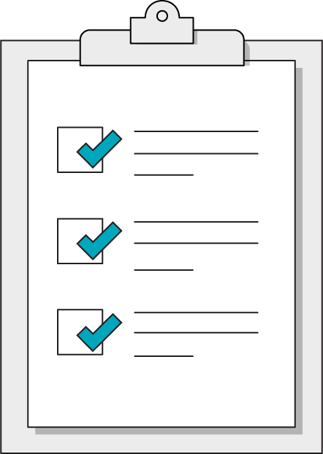
Today’s Learning Objectives
In this lesson, you will:
Define media query breakpoints to apply separate rules based on screen size.
Use responsive measurements such as ems to smoothly scale CSS rules to devices.
Apply a mobile-first methodology to CSS and website design.
‹#› | © 2020 General Assembly
Notes:
DURATION: 1 minute
TEACHING TIPS:
Learning objectives help frame the lesson and give students an idea of what to expect and focus on.
Explain to students how this lesson fits into the overall course to help them make connections with content from other lessons.

Slide 7
Responsive Design and
Media Queries
Front-End Web Development

Slide 8
A Bit of Background
The iPhone, unveiled in 2007, changed how people used the internet. It took until ~2009 to become popular.
This was first addressed by creating mobile-specific sites (started with m.site.com), which meant you had to make multiple sites! Yuck.
As browsers evolved, it became possible (by 2010) to build one site where you could adjust styles based on screen widths, creating one site for all devices.
Ethan Marcotte pioneered this technique with an article on the subject: http://alistapart.com/article/responsive-web-design.

Slide 9

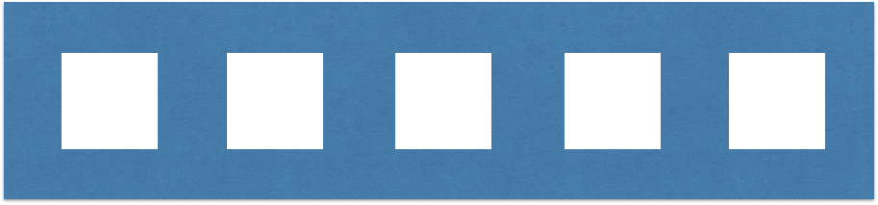
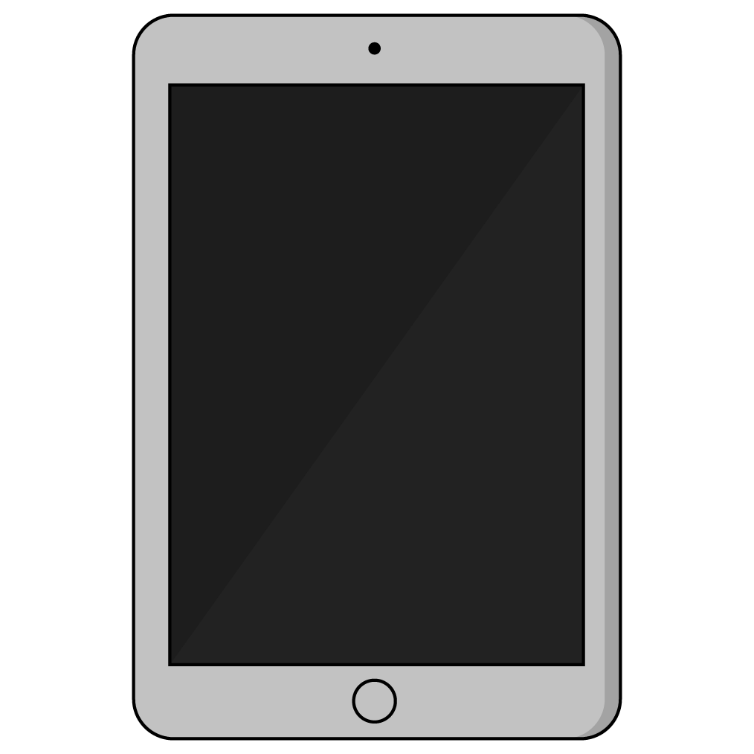
Why?
Laptops/desktops have horizontal orientations.
Designers can place several elements next to each other with plenty of room.

Slide 10
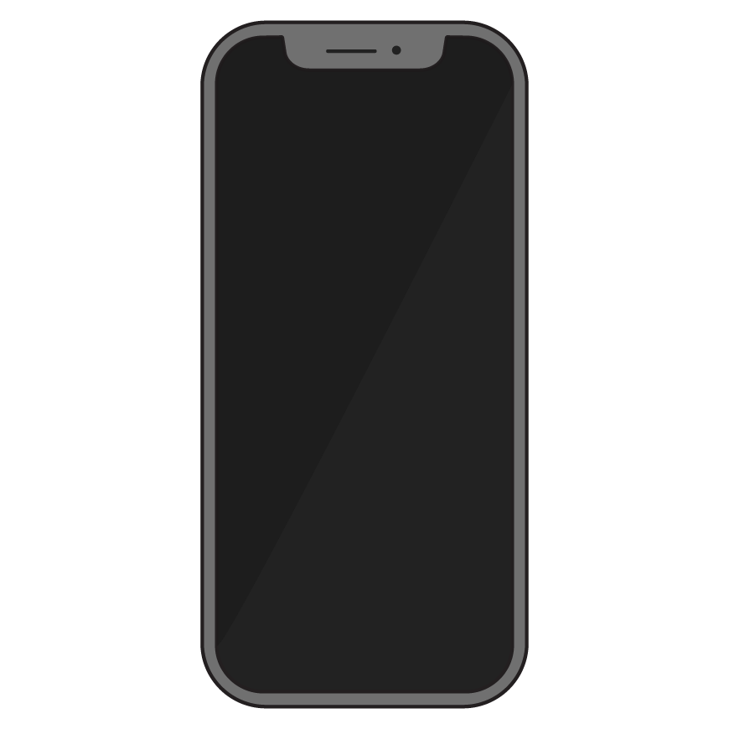
Why? (Cont.)
Tablet/mobile phones have vertical orientations.
Content should rely on having many rows of one item each. There’s not enough room for more!

Slide 11



Good Mobile Design: FTC.gov
Desktop
Mobile
Notes:
TALKING POINTS:
Mobile devices stick to one item per horizontal space and rely on vertical scrolling instead. The nav bar becomes the “hamburger” three-line icon, which reveals a vertical menu when tapped. Go to the site and check it out!

Slide 12

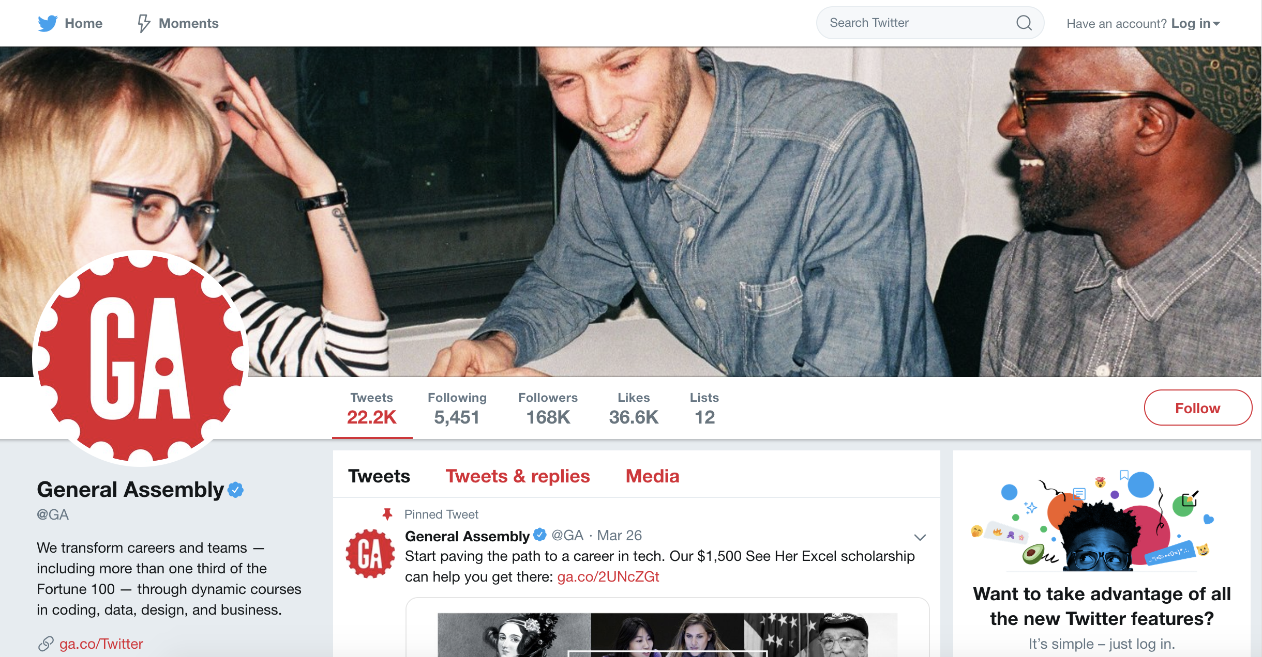
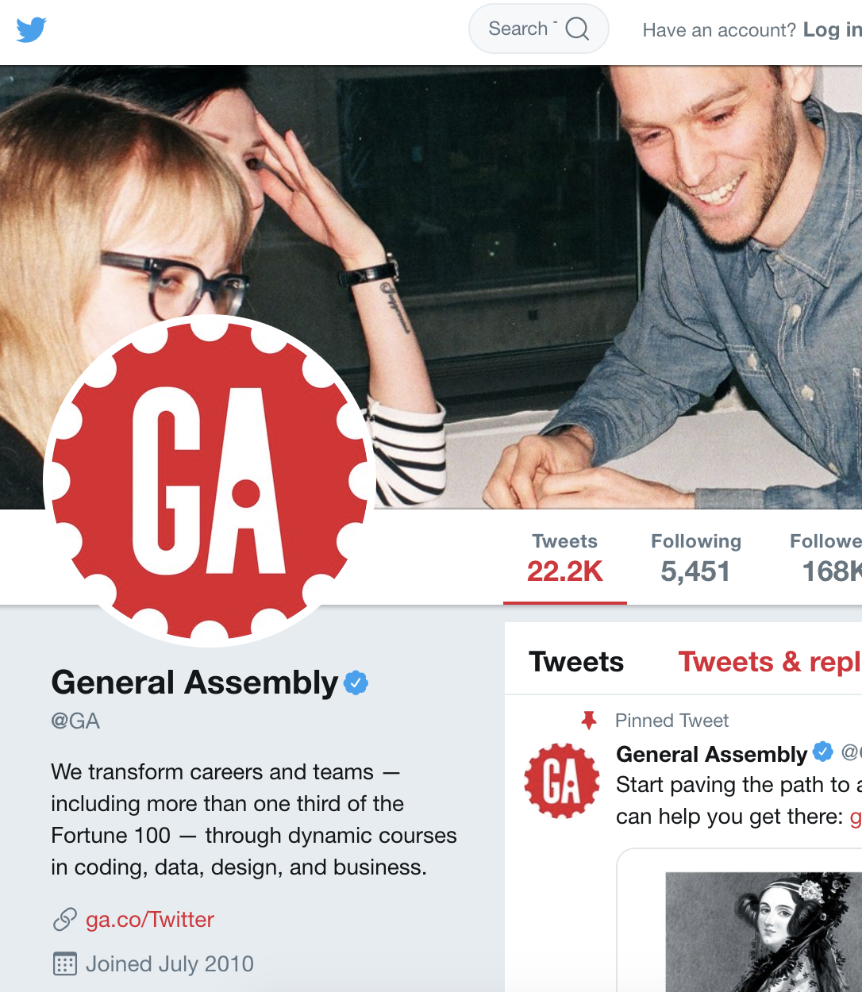
Less Good Mobile Design: Twitter.com
Desktop
Mobile
Notes:
TALKING POINTS:
Note how the smaller version just cuts things off and doesn’t reorient or scale anything!

Slide 13
Screen Sizes
Think about device widths and CSS cascading. How would we target these?
iPhone SE/iPhone 5S = 320px
Galaxy/iPhone 6 = 380px - 400px
iPhone 6+, Galaxy Note = 420px
Phablet/tablet = 500px–650px
iPad/iPad mini = 768px
Laptops = 960px–1200px
Desktops = 1024px–1800px
Notes:
Source: http://screensiz.es/phone

Slide 14
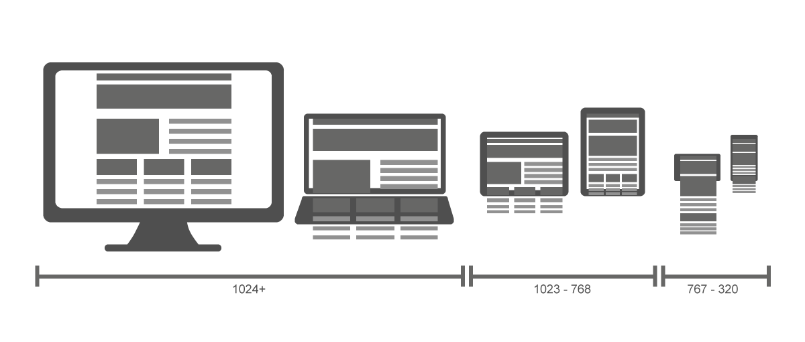
Device Grouping

Slide 15

Device Grouping
Phones
Tablets
Laptops & Desktops
iPhone SE/iPhone 5S = 320px
Galaxy/iPhone 6 = 380px– 400px
iPhone 6+/Galaxy Note = 420px
Phablet/tablet = 500px–650px
iPad/iPad mini = 768px
Laptops = 960px–1200px Desktop = 1024px–1800px

Slide 16
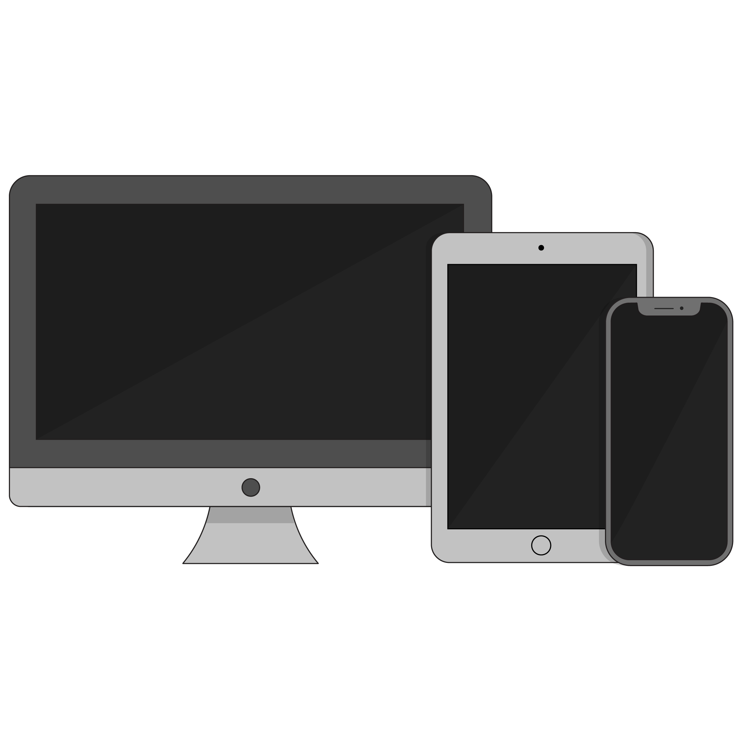
Good Breakpoints
480 pixels // phones
768 pixels // tablets
960 pixels // small screens
1200 pixels // big screens
Target your styles against these breakpoints (you can make others, but these are versatile).

Slide 17
Two Approaches to Responsive Design
Three Breakpoints: Mobile, Tablet, Desktop
Many Breakpoints: Component-based Breakpoints
Notes:
TALKING POINTS:
The http://ami.responsivedesign.is/ site displays the major devices and how a website will render on each of them.

Slide 18
Viewport
<meta name="viewport" content="width=device-width, initial-scale=1">
You have to tell the browser you want the page to be responsive. Include this code above the head. This tells the browser to scale the page to the device that’s viewing it.
Notes:
Source: W3School: The Viewport
TALKING POINTS:
Per Shay Howe: Using the viewport meta tag with either the height or width values will define the height or width of the viewport, respectively. Each value accepts either a positive integer or keyword. For the height property, the device-height keyword is accepted, and for the width property the device-width keyword is accepted. Using these keywords will inherit the device’s default height and width values.

Slide 19
@media Query
Syntax is a bit weird at first, though. You’ll potentially see @ rules for the first time in CSS (others exist: @import, @keyframes).
What does this code do? What is being targeted?
@media (min-width: 480px) {
.text-design {
font-size: 24px;
}
}
Notes:
TEACHING TIPS:
As you walk through this, you might have to draw out some different example devices and outputs on the whiteboard.

Slide 20
The Media Query
.text-design {
font-size: 18px;
}
@media (min-width: 480px) {
.text-design {
font-size: 24px;
}
}
Target a min-width with @media and provide property/value pairs inside of the current style sheet. The code really is this easy but there’s more to consider.
Notes:
Source: W3School: @media Rule
TEACHING TIPS:
As you walk through this, you might have to draw out some different example devices and outputs on the whiteboard.
A good example to view in DevTools is the H1 on the https://generalassemb.ly/ site, as it alternates between 2.4rems (min-width:720px) and 2.5rems (mobile).
TALKING POINTS:
Sites such as http://ami.responsivedesign.is/ are used to test the responsive design implemented by any site accessible via the web.

Slide 21
Mobile-First
In mobile-first design, styles start with mobile and cascade to larger screens. This is the preferred way of implementing responsive design, as mobile screens are harder to accommodate and design retroactively.
2
1
3
Notes:
TALKING POINTS:
The http://ami.responsivedesign.is/ site displays the major devices and how a website will render on each of them.

Slide 22
Thinking Time
Discussion
What are the pros and cons of each approach to breakpoints?
Notes:
Let the students think through whether it’s good to have 3 fixed breakpoints or continuous breakpoints
Ask them to consider the non-technical aspects
3-breakpoints is easier for clients and designers to preview the work
Continuous breakpoints allow for a wider range of sizes and possibly better use of screen real estate

Slide 23
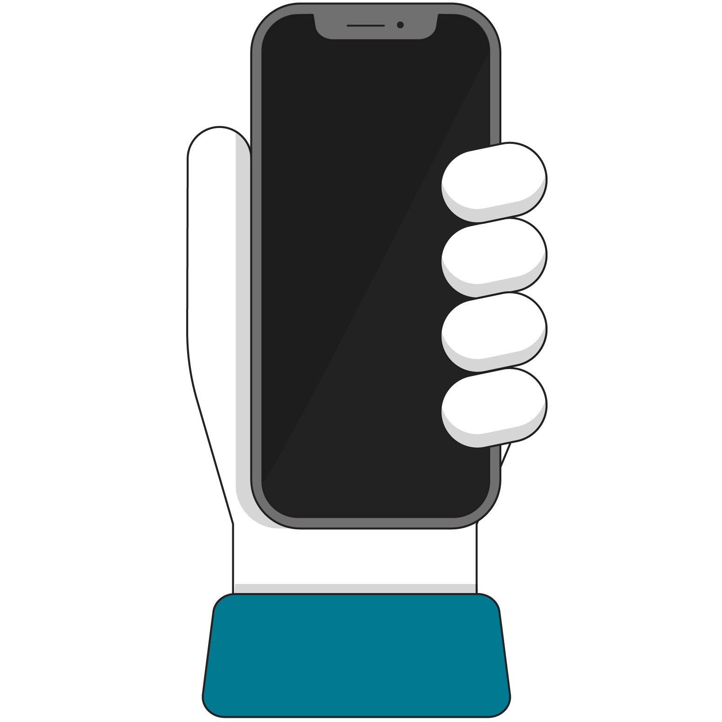
Using Media Queries With Layout
How you actually use media queries depends on your layout method. Generally, you’re adjusting both layout (flex, grid, etc.) and finish work (font, background, color).
First, let’s make the layout responsive!

Slide 24
Responsive Layouts
Refer to the following CodePen for examples of specific responsive layout properties.
Reference code:
https://codepen.io/GAmarketing/pen/NWWeNPw

Slide 25
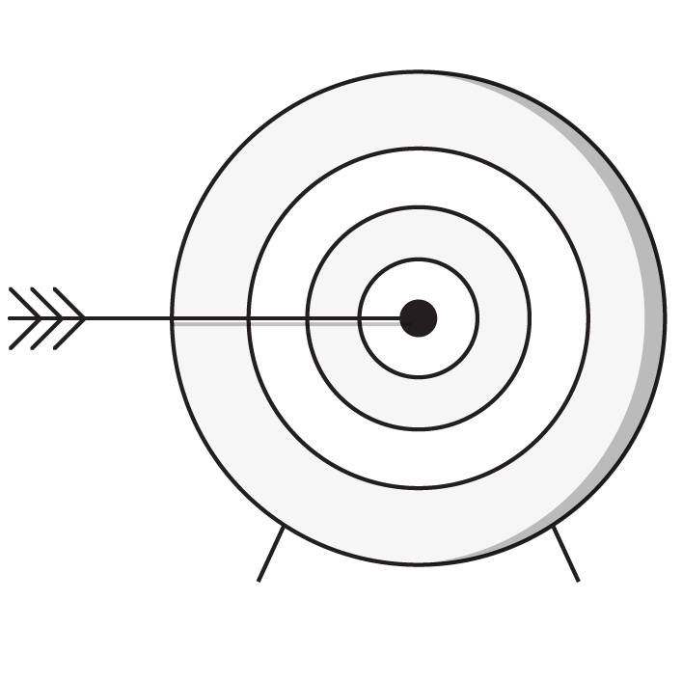
Targeting Non-Width Values
You can also tailor CSS around other attributes of the device that’s viewing your work. Things such as device type, screen resolution, and others are available but less common than width.
Here’s a full list of things you can target:
https://developer.mozilla.org/en-US/docs/Web/CSS/Media_Queries/Using_media_queries

Slide 26
Media Types
Typically, all you would use is the screen type. Many sites leave it out altogether now.
Media Type | Description
all | Suitable for all devices
print | Styles for printed documents
screen | Phones, tablets, TV, watches, computers
speech | Screen readers for accessibility
Notes:
TEACHING TIPS:
Students almost never struggle with this. I’d just comment that most people leave out type now, because everything registers as a screen. (Although speech was just added; it might be interesting to show some accessible examples, if anyone knows of one.)

Slide 27
Media Features (abridged)
There are a handful of targetable features that we regularly use. There are a lot more that are almost never used.
Media Type | Description
width | Suitable for all devices
height | Styles for printed documents
orientation | Phones, tablets, TV, watches, computers
Notes:
TEACHING TIPS:
Students almost never struggle with this. I’d just comment that most people leave out type now, because everything registers as a screen. (Although speech was just added; it might be interesting to show some accessible examples, if anyone knows of one.)

Slide 28
Compound Media Query With Type and Width
@media screen and (min-width: 480px) {
.my-class {
property: value;
}
}
Almost all devices register as screen, making this largely irrelevant, but you’ll see it in older codebases.
The only use case in which you see “type” in the wild is when making style sheets for documents that print (such as concert tickets or boarding passes). Even this use case is dying because of mobile apps that perform these tasks.
Notes:
TEACHING TIPS:
Students almost never struggle with this. I’d just comment that most people leave out type now, because everything registers as a screen.

Slide 29
The Media Query
@media (min-width: 768px) and (max-width: 959px) {
.text-design {
font-size: 20px;
}
}
@media (min-width: 30rem) and (orientation: landscape) {
.text-design {
font-size: 18px;
}
}
Notes:
Source: W3School: @media Rule
TEACHING TIPS:
As you walk through this, you might have to draw out some different example devices and outputs on the whiteboard.
A good example to view in DevTools is the H1 on the https://generalassemb.ly/ site, as it alternates between 2.4rems (min-width:720px) and 2.5rems (mobile).
TALKING POINTS:
Sites such as http://ami.responsivedesign.is/ are used to test the responsive design implemented by any site accessible via the web.

Slide 30
Another Approach: Separate Responsive Style Sheets
<link rel="stylesheet" media="screen and (min-width: 1024px)" href="css/1024only.css">
Separate style sheets are rare but still valid.
Notes:
TEACHING TIPS:
Some developers put all mobile/tablet styles in a separate sheet. Others prefer inline responsive styles so they can better track what's going with an element on a per-style basis. Both methods work.
Separate style sheets are rarely used anymore, with the rise of Sass (a CSS preprocessor that favors inline media queries) and Angular/React/Vue (component-based JavaScript frameworks).

Slide 31
Group Responsive Exercise
20-30 Minutes
In this example, we have a bunch of elements to play with: Different layouts, different methods, and even a few responsive images.
Try to adjust the layout, images, and text. You can look forward in the lesson to see how to make images and text responsive.
Starter code:
https://codepen.io/GAmarketing/pen/BaavpoG
Solution code:
https://codepen.io/GAmarketing/pen/WNNLRRq
Notes:
TEACHING TIPS:
Walking through these might lead to a code-along you want to do to demo some of this. If you let students go long enough, bring everyone back and talk through what’s going on. There aren’t wrong answers to this; just have them explore. The biggest thing to examine is how to make flex and grid be responsive. Also, look at the floated image.
Add a link to the live view of the CodePen solution so they have something to work off of, and possibly use DevTools to explore.

Slide 32
Responsive Units and Typography
Front-End Web Development

Slide 33
em
.class-cool {
font-size: 2em;
}
em is a unit of measurement derived from print design (based on the size of “M,” which is the largest letter).
It’s a sizing unit based on a parent element's size.
If .class-cool is inside a container with font-size: 16px;, what size is the font in pixels?
Notes:
TALKING POINTS:
The first answer is 32px. The second answer is 64px, as the direct parent’s font size is now 32px. We can use rem to avoid the nesting issue if we’d prefer to always work relative to a single value for the whole document; we’ll rem discuss later.

Slide 34
Sensible Usage
Set a specific value in px on body:
Base other styles on it:
body {
line-height: 12px;
}
h1 { line-height: 2.5em; } // 30px
h2 { line-height: 2em; } // 24px
Notes:
TEACHING TIPS:
You can talk about vertical rhythm as a possible deep-dive topic for visual design-oriented students or those considering UX design as a specific application of the course’s skills.
Here’s a good article on vertical rhythm.

Slide 35
Thinking Through It
body {
font-size: 10px;
}
div {
height: 5em; // 50px
width: 3em; // 30px
margin: 0.5em; // 5px
border: 0.1em; // 1px
}
Like ALL units, you can use em’s for anything that requires a size.

Slide 36
Avoid ems Within ems!
<div class="container">
<h2>How big is this title?</h2>
</div>
body {
font-size: 10px;
}
div {
font-size: 1.6em; // 16px
}
h2 {
font-size: 1.1em; // 17.6px
padding: 0.55em; // 8.8px
margin: 0.2em; // 3.2px
}
ems can quickly become a tangled mess of fractions on fractions when nested elements are concerned.
The example to the right shows just how tricky they can get!
Notes:
TALKING POINTS:
One of the pitfalls of ems is nested values, which compound each other and make tweaks brittle and difficult to track down
In this example, the h2 is 1.1x as large as the font size of the div, which is itself 1.6x as large as the font size of the body (12px).

Slide 37
There is rarely a compelling reason to use EM but there is often good reason to use REM.
‹#› | © 2021 General Assembly

Slide 38
rem
.class-cool {
font-size: 2rem;
}
Not a band or a phase of sleep but rather root EM.
It fixes the parent inheritance problem of em: The sizing won't change depending on nesting (kind of like how percentages change based on parent but vh/vw do not).

Slide 39
rem
.class-cool {
font-size: 2rem;
}
REM is defined as equal to the font-size of the root element.
(this is almost always the body)

Slide 40
rem In Practice
/* Won’t change based on HTML nesting, still nasty at times */
body {
font-size: 12px;
}
div {
font-size: 1.6rem; // 19.2px
}
h2 {
font-size: 1.1rem; // 13.2px
padding: 0.55rem; // 6.6px
margin: 0.2rem; // 2.4px
Notes:
TEACHING TIPS:
This should more intuitively line up with students’ expectations.

Slide 41
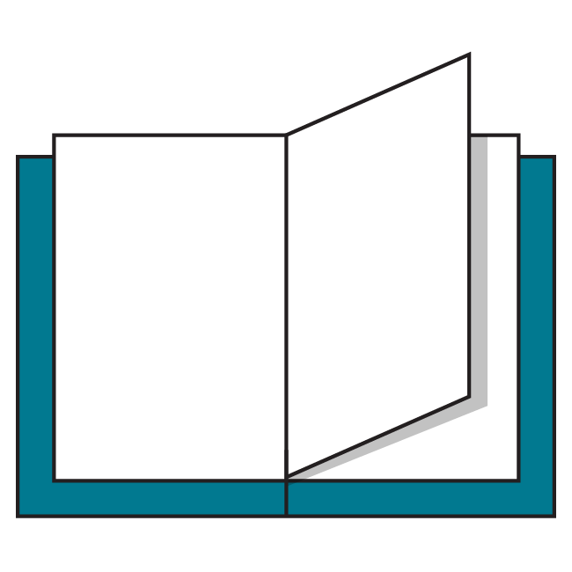
Additional Reading
Pixel + em + REM technique: https://css-tricks.com/rems-ems/
Pitfalls of em and REM, but everything can work given enough patience: http://zellwk.com/blog/rem-vs-em/

Slide 42
vh And vw Units
You can also use percentages of the viewport called vh and vw. There are 100 viewport height and 100 viewport width units per any screen you view (which is very similar to percentages!).
.container {
height: 100vh; /* full height of screen */
width: 50vh; /* half of width of screen */
}
Reference code:
https://drive.google.com/drive/folders/1gKVOGl6kqmerx156e_-LW1RVa6HEDycJ?usp=sharing

Slide 43
Percentages vs. vh/vw Units
The biggest difference? Nesting an element with percentage means it is bound by its parent. Viewport units will still be the same no matter how nested they are.
<section class=”container”>
<div class=”child-1”>Percent</div>
<div class=”child-2”>vw Units</div>
</section>
.child-1 {
width: 50% /* 50% of its parent */
}
.child-2 {
width: 50vw; /* 50% of the entire screen*/
}

Slide 44
Startup Matchmaker Member List
30–45 minutes
The Startup Matchmaker has built a member list but is not mobile-friendly. Let’s make it work at any size!
Starter code:
https://drive.google.com/drive/folders/1rqQMUXrbUDOaS5FEC_bQ1aOTzpuATnyj?usp=sharing
Solution code:
https://drive.google.com/drive/folders/1FOeHzIHcZ-cjs3ERpMSavZ7kYGL-oC3m?usp=sharing
Notes:
TEACHING TIPS:
Walking through these might lead to a code-along you want to do to demo some of this. If you let students go long enough, bring everyone back and talk through what’s going on. There aren’t wrong answers to this; just have them explore. The biggest thing to examine is how to make flex and grid be responsive. Also, look at the floated image.

Slide 45
Responsive Images
Front-End Web Development

Slide 46
Images Sized to Their Containers
.image-style {
display: block;
max-width: 100%;
height: auto;
}
Images want to display at their dimensions (say, 800 x 600px), but they’ll often be in containers and will spill over if they’re bigger. This code forces the image to be a block element whose width matches its container.
Why does this work?
Notes:
TALKING POINTS:
The width of the container is the maximum amount of width the image can take up, so they stay in sync. The automatic height adjusts to keep the height of the image in sync with the changing width. Together, the image responds without warping or stretching.

Slide 47
HTML srcset + sizes Attributes
Figuring out which image should go to a particular device is cumbersome and nearly impossible. Now, you can tell the browser how much of the screen an image takes up (with the sizes attribute) and give it the image at different sizes (srcset). The browser does the rest.
Both sizes and srcset are attributes you can optionally add to any <img> tag you want to enable.
Notes:
Source: https://www.w3schools.com/tags/att_source_srcset.asp

Slide 48
Code Sample: HTML srcset + sizes
<div class=”image-container”>
<img src=”img/image-large.jpg” alt=”Forest Lands”
srcset=”img/image-large.jpg 1200px,
img/image-medium.jpg 800px,
img/image-small.jpg 400px”
sizes=”(min-width: 1200px) 33vw,
(max-width: 1199px) and (min-width: 768px) 50vw,
100vw”>
</div>
The code is a doozy! We’re telling the browser we have three of the same image with various pixel widths, and then what size the image displays at a given screen width.

Slide 49
Responsive Background Images
.image-style {
background-image: url(img/image.jpg);
background-position: center center;
background-size: cover;
}
Background images are somewhat natively responsive; they won’t spill out of their containers. But containing elements will crop the image.
To adjust which part of the image you see, use background-position and background-size. In particular, background-size: cover; is pretty close to magic: It uses an algorithm to make the image match its container.

Slide 50
Responsive Image Investigation
Let’s see how a browser handles a responsive image.
Reference code:
https://drive.google.com/drive/folders/1H5wPU6aFhKSWGpimJp6-t3waBlkfNasx?usp=sharing

Slide 51
Responsive Navigation
Front-End Web Development

Slide 52
Add a Menu
30–45 minutes
Let’s keep building the Startup Matchmaker Member List. Add a menu AND make it mobile friendly by expanding and contracting with a hamburger icon.
Starter code:
https://drive.google.com/drive/folders/19w7bXlnJE-c5NW_4C7vlk4Yl7LAM-F5H?usp=sharing
Solution code:
https://drive.google.com/drive/folders/108K1sN_Z1CYIxk_EVF2kND_mG0xCOZja?usp=sharing
Notes:
TEACHING TIPS:
Spend some time with the students talking about hamburger and kabob menus.
Make sure they pseudo-code the mechanics

Slide 53
Key Takeaways
For Next Time
Mobile-First Development
The position Property
Using responsive units can ensure usable websites, regardless of device size.
It’s most effective to think about mobile screens first, then expand content for larger browsers.
We can use the position property to move elements around the page.

